Slide 1
Data Mining Cup 2017 Revenue Forecast of Mail Order Pharmacy
Final presentation
Data and Web Science Group
University of Mannheim
Alexander Brinkmann, Liane Gybas, Daniel Helfer, Nancy Kunath, Florian Schrage, Timo Sturm, Steffen Terheiden, Christoph Wagner
23.05.2017

Slide 2

Overview
Selection
Preprocessing
Transformation
Data Mining
Evaluation & Interpretation
Available data
…….
Target
Data
Preprocessed Data
Transformed Data
Patterns
Adopted from Fayyad et al. (1996)

Slide 3
DMC 17 - Challenge
Original task
Two step model
Adjusted two step model
Trend splitting model
Split data based on trend analysis
Predict the type of user action (Click/Basket =1 vs. Order =1)
Predict the type of user action (Click/Basket =1 vs. Order =1)
Predict the type of user action (Click/Basket =1 vs. Order =1)
Predict the revenue for every user action
Predict the quantity for all “order” actions
Predict the quantity/revenue for all “order” actions
Predict the revenue for all “order” actions
Evaluate result based on trend analysis
Regression problem
Classification problem
Trend analysis

Slide 4
Preprocessing
Selection
Preprocessing
Transformation
Data Mining
Evaluation & Interpretation
Available data
…….
Target
Data
Preprocessed Data
Transformed Data
Patterns
Adopted from Fayyad et al. (1996)

Slide 5
Feature Understanding and Engineering
Preprocessing – Feature Understanding/Engineering
A Short Summary about our feature understanding steps:
analysed for missing values
searched for outliers
Releted to specific field how: „pharmForm“ with 278 in 3-digit strings.
We interviewed a pharmacist, so we understand the policy of dosage codes and acronyms how e.g. „NTR“ = „Nasentropfen“
Sales index that was descriped in dispensing regulation codes
We analysied the correlation between the given attributes
Also we find out that 82 products were „always“ bougth.
In the other way we saw that 3100 products were never bought
And the import step for the dataset split after the 22nd day
Notes:
Outlier – 0 too low

Slide 6
Feature Understanding and Engineering
 | Judgment of the Court (First Chamber - EuGH) of 19 October 2016: Deutsche Parkinson Vereinigung eV vs Zentrale zur Bekämpfung unlauteren Wettbewerbs eV Setting of fixed prices for medicine, which are only available on prescription, is against European Law
Attribute | Till 19th | Starting from 20th
PriceRatioCompetitor | 0.152 to 3.232 | 0.003 to 53.497
PriceRatioRPP | 0.055 to 3.946 | 0.013 to 6.885
→ Prices are more volatile
Notes:
Outlier – 0 too low

Slide 7
Feature Understanding and Engineering
Preprocessing – Feature Understanding/Engineering
A Short Summary about our feature engineering steps:
in whole our final dataset holds 111 features
89 features based on transformation, combination, interpretation and with influence of external informations. (start data set 22 features)
After analyises with weight of GTB we reduced the final set to 44 features.
One of most importan feature was the Basket feature based on order blocks
Erklärung wie dieses erstellt wurde ist wichtig für unseren Ansatz
Liste Seite 6 aus Report über die choices???
Notes:
Outlier – 0 too low

Slide 8
Data Mining and Evaluation
Selection
Preprocessing
Transformation
Data Mining
Evaluation & Interpretation
Available data
…….
Target
Data
Preprocessed Data
Transformed Data
Patterns
Adopted from Fayyad et al. (1996)

Slide 9
Data Mining and Evaluation
Diese Folie wird noch gelöscht
Baseline
One Step, Two Step Model (welches der beiden war am Ende unser Favorit und warum)
Trendanalyse und Erkenntnis: Coole Sachen erwähnen wie: Judgment of the Court
Processe zeigen zu Order predicton One Step, Two Step
Evaluierung der Processe und des Errors.
Aussicht geben:
Was hätte man noch machen können
Notes:
Outlier – 0 too low

Slide 10
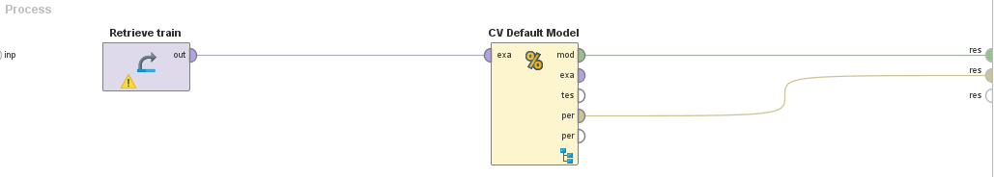
Data Mining and Evaluation
Baseline
Performance of the Default Model
Median: RMSE* = 10.904
Average: RMSE = 10.238
For comparison, basic Gradient Boosted Tree: RMSE = 9.679
*RMSE : Root Mean Squared Error
Notes:
Informations for the baseline

Slide 11
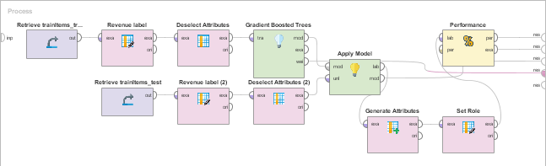
Data Mining and Evaluation
One-Step
Performance of the Default Model
Median: RMSE* =
Average: RMSE =
For comparison, basic Gradient Boosted Tree: RMSE =
*RMSE : Root Mean Squared Error
Notes:
Informations for the baseline

Slide 12
Data Mining and Evaluation
One-Step
Definition des Aufbaus
Und Gründe warum wir diesen fokussiert haben
Aus dem Report:
Notes:
Outlier – 0 too low

Slide 13
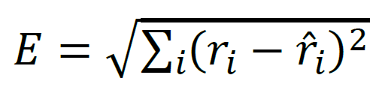
Data Mining and Evaluation
Evaluation takes place on example level
Difference between actual value and prediction is squared
Performance Measurement
Our result: E = 8.5xx

Slide 14
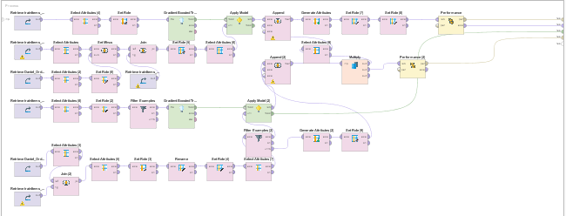
Data Mining and Evaluation
Two-Step
Performance of the Default Model
Median: RMSE* =
Average: RMSE =
For comparison, basic Gradient Boosted Tree: RMSE =
*RMSE : Root Mean Squared Error
Notes:
Informations for the baseline

Slide 15
Data Mining and Evaluation
One-Step
Definition des Aufbaus
Und Gründe warum wir diesen NICHT fokussiert haben
Aus dem Report:
Notes:
Outlier – 0 too low

Slide 16
Data Mining and Evaluation
Other approach sliding window
--- Bild fehlt noch
Performance of the Default Model
Median: RMSE* =
Average: RMSE =
For comparison, basic Gradient Boosted Tree: RMSE =
*RMSE : Root Mean Squared Error
Notes:
Informations for the baseline

Slide 17
Data Mining and Evaluation
Other Approach
Was war hier der Ansatz wenn wir rausfinden wollten
Notes:
Outlier – 0 too low

Slide 18
Summary and Lessons learned
Erkentnisse was haben wir gelernt was hat uns der DMC 17 gebracht
Rapid Miner
Datenverständnis, Organisation in größeren Projektteams
Realworld Projektumsetzung
Python
R
Was hätten besser machen können
Notes:
Outlier – 0 too low

Slide 19
Questions?
Feel free to ask!

Slide 20
Backup Slides
Slide mit den 44 features?
Slide mit R Code?

Slide 21
Informationssammlung für die Präsentation
Zeigen was wir alles gemacht haben und was bei rum kam
Preprocessing – Feature Understanding/Engineering
Welchen Dingen sind wir nachgegangen, dann aber Fokus auf welche waren wirklich wichtig für unser Vorhaben.
Created/engineered 97 Features – Most important???
What have we done in the last week, Basket Feature understanding
Which features we created in last week
Some cool findings: Judgment of the Court
Data Mining and evaluation
Baseline best findings
Creation of Order prediction process: What have we doen to improve
Creation of on step and two step model: GBT imporvments?

